Slide 1
How to support children to cope with their parent’s imprisonment and enhance their potential to lead safe, included, happy, achieving lives?
Children of Prisoners Europe: the COPE network
Hannah Lynn | Kate Philbrick
Children of Prisoners Europe (COPE)
contact@networkcope.eu
10 January 2017
Quality of Childhood session
European Parliament

Slide 2
Structure
Children of Prisoners Europe
The issue
The children’s needs
The children’s rights
Influencing change
Framing
What we do
Progress so far
Looking forward…

Slide 3
The child’s needs
Children of Prisoners Europe
800,000 voices (and the need for case-by-case analysis)

Slide 4
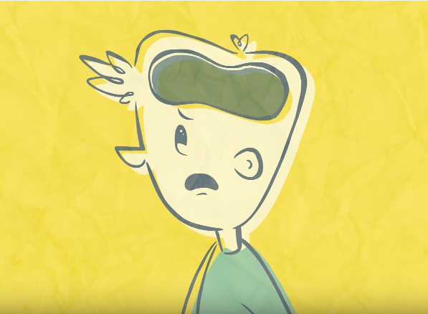
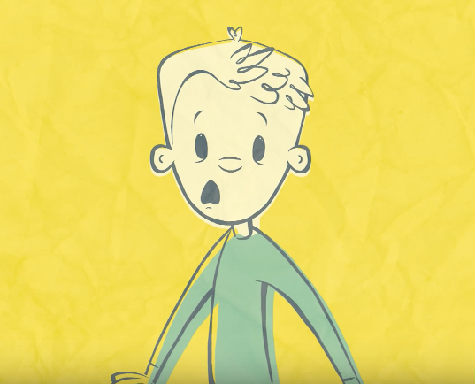
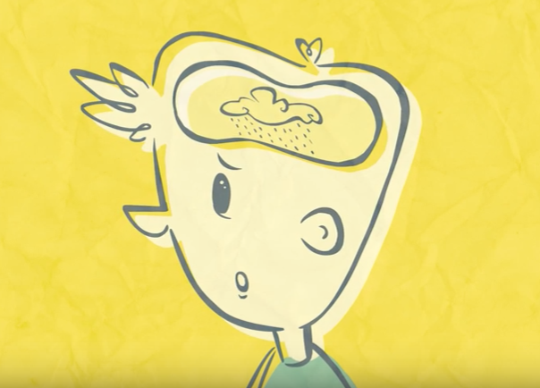
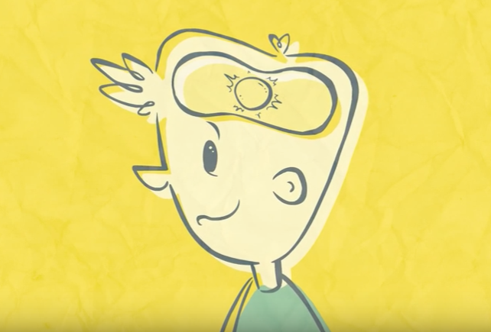
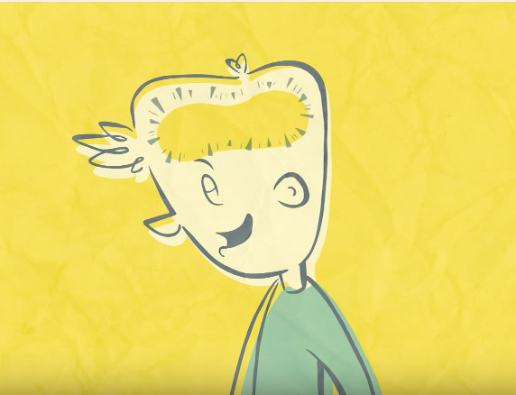
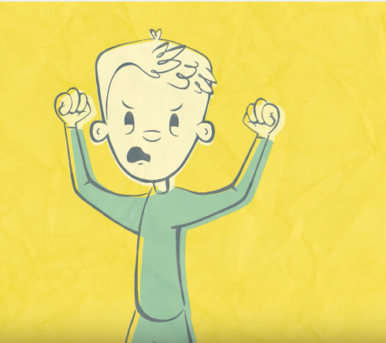
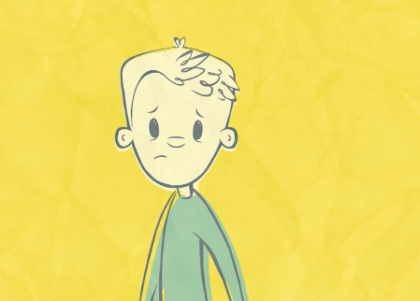
Children of Prisoners Europe

Slide 5
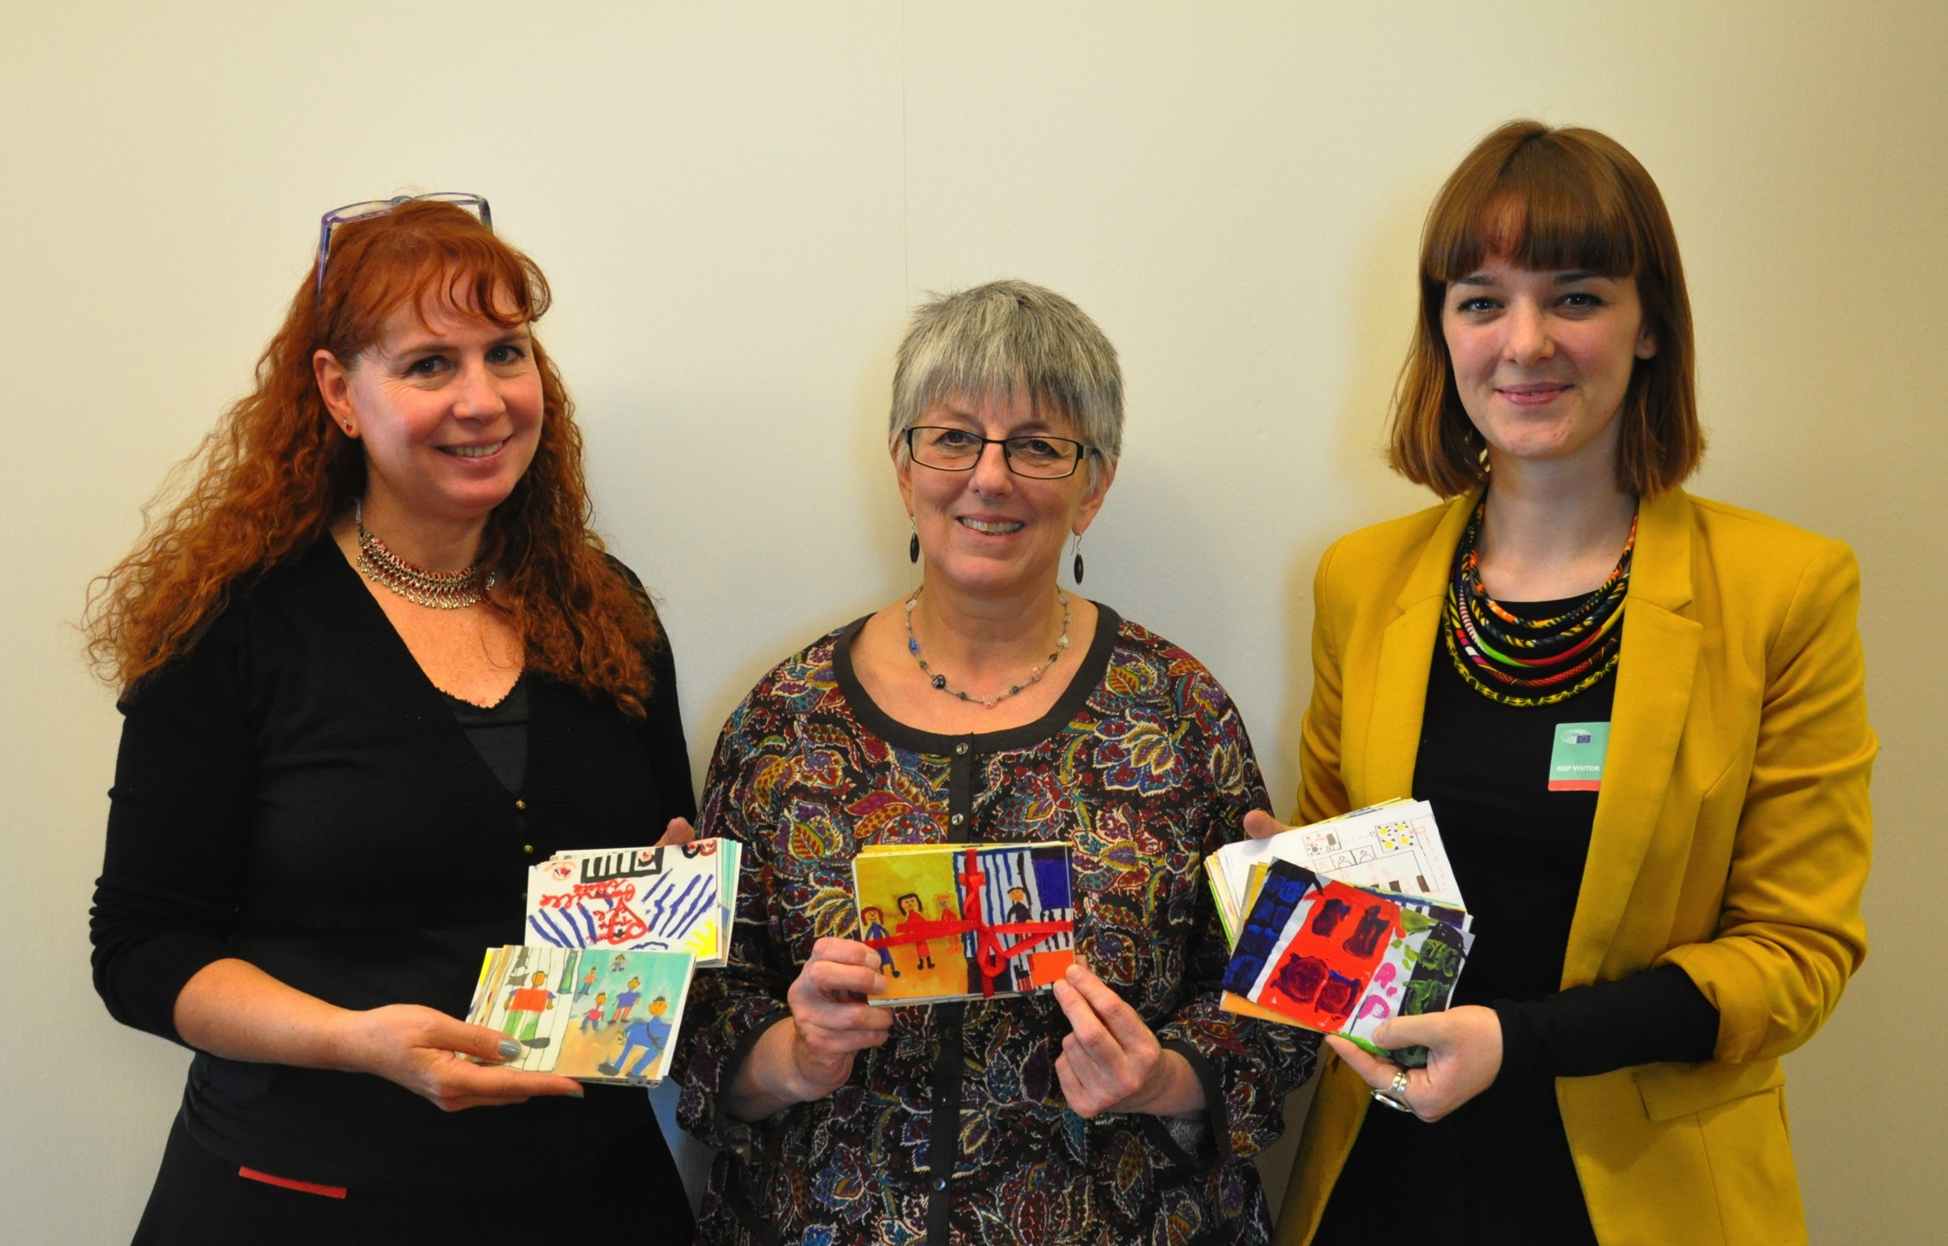
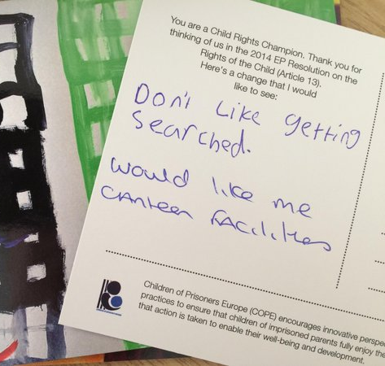
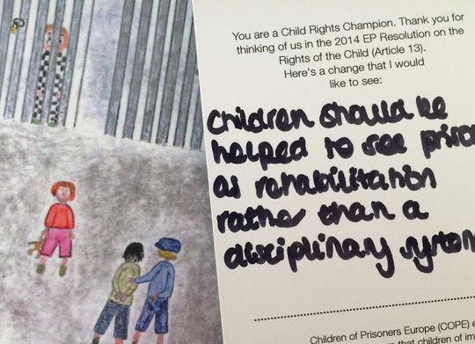
Children of Prisoners Europe

Slide 6
Resilience factors - positive
Children of Prisoners Europe
Enhanced support from NGOs, agencies, counseling if needed
Role of care-giving parents and extended family
Honesty and openness
School Support
Early continuing and good quality contact and openness with imprisoned parent
Peer Support
Children able to confide in an adult
Source: Martin Manby

Slide 7
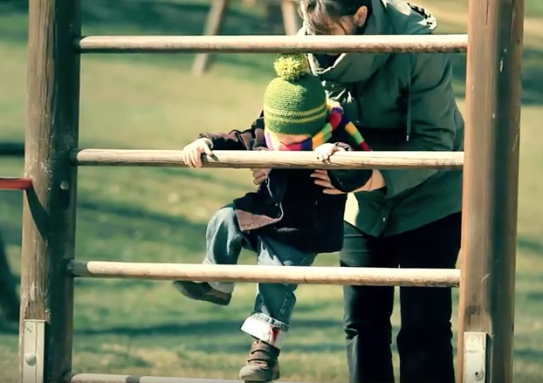
Protecting the child-parent bond (part 1)
Children of Prisoners Europe
Protection from humiliation

Slide 8
Protecting the child-parent bond (part 2)
Children of Prisoners Europe
Alain Bouregba:
Comment l’incarcération altère la conduite de l’individu /
How incarceration alters the child-parent relationship
Video documentary: https://goo.gl/wO62Tk

Slide 9
The rights of the child
Children of Prisoners Europe
European Convention on Human Rights (1953):
Article 8: Everyone has the right to respect for their private and family life
United Nations Convention on the Rights of the Child (1989)
Articles:
2: right to protection from discrimination on the basis of the status or activities of the child’s parents;
3: right to have their best interests taken into consideration;
9: right to contact with their parents;
12: right to express their views in all matters concerning them.
as well as 5, 6.2, 9.1, 31…
Charter of Fundamental Rights of the European Union (2000/2009):
Article 24: Rights of the child to protection, care, well-being, express views freely, best interests and the right to maintain a personal and direct relationship with both parents

Slide 10
A multi-sectoral issue
Children of Prisoners Europe
Health and mental health protection
Provision for children (schools, child protection, etc.)
Police
Justice system
Penal system
Social welfare
NGOs, COPE...
Researchers
Ombuds-persons
With thanks to: Maja Gabelica Šupljika

Slide 11
Children of Prisoners Europe
Frame-reflective advocacy
Types of target populations |  | SOCIAL CONSTRUCTION OF POPULATION (US)
 |  | Deserving | Undeserving
POWER | Strong | ADVANTAGED Business Veterans Scientists | CONTENDERS The rich Big unions Cultural elites Moral majority
 | Weak | DEPENDENTS Children Mothers Disabled | DEVIANTS Criminals Drug addicts Gangs
Source: Schneider and Ingram,1993:336

Slide 12
Children of Prisoners Europe
(Re)framing dynamic: Children of prisoners
 |  | SOCIAL CONSTRUCTION OF POPULATION
 |  | Deserving | Undeserving
POWER | Strong
 | Weak
Holistic
Instrumental
Victim
stigma
Source: Paul Stubbs & Anka Kekez-Kostro

Slide 13
A multi-sectoral issue
Children of Prisoners Europe
… with multi-sectoral importance
Health and mental health protection
Provision for children (schools, child protection, etc.)
Police
Justice system
Penal system
Social welfare
NGOs, COPE...
Researchers
Ombuds-persons
With thanks to: Maja Gabelica Šupljika
Benefiting:
child (psychological, rights, interests, school, family life…)
imprisoned parent
caregiver(s)
the prison (dynamic security)
police
government
sectors of health and mental health protection
schools
the taxpayer (reducing reoffending / trans-generational offending)
the EU and its Member States

Slide 14
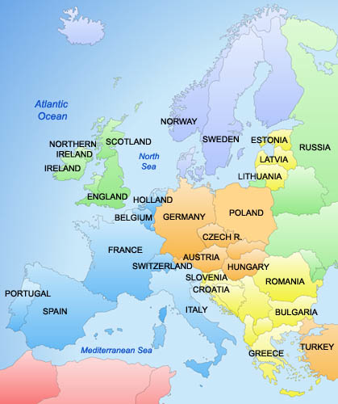
Where does the COPE network span?
Children of Prisoners Europe
• The only pan-European network
• Members, partners or contacts in all EU States
• Active within prison-related, child rights and welfare fields
• Awareness-raising and new ways of thinking, acting and interacting
• Foster cross-sphere collaboration (public and private agencies)

Slide 15
COPE’s pyramid of priorities
Children of Prisoners Europe
Changing policies
Changing norms
Changing attitudes and behaviour
Maximising service provision

Slide 16
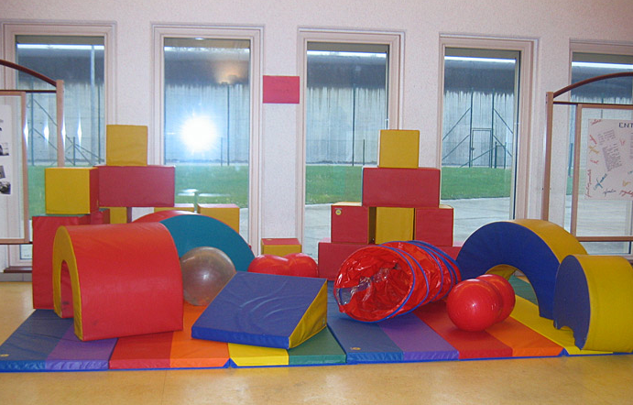
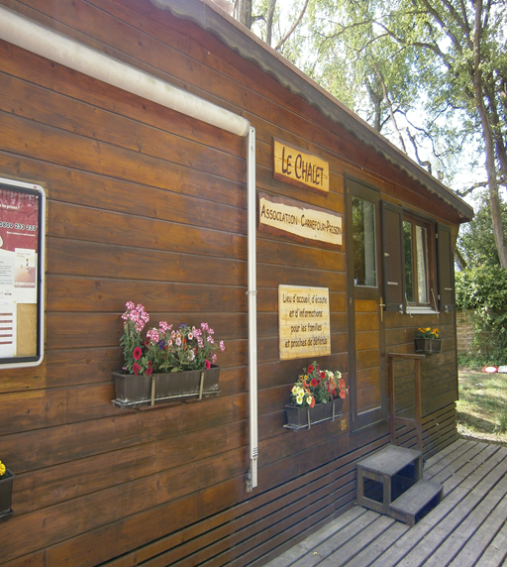
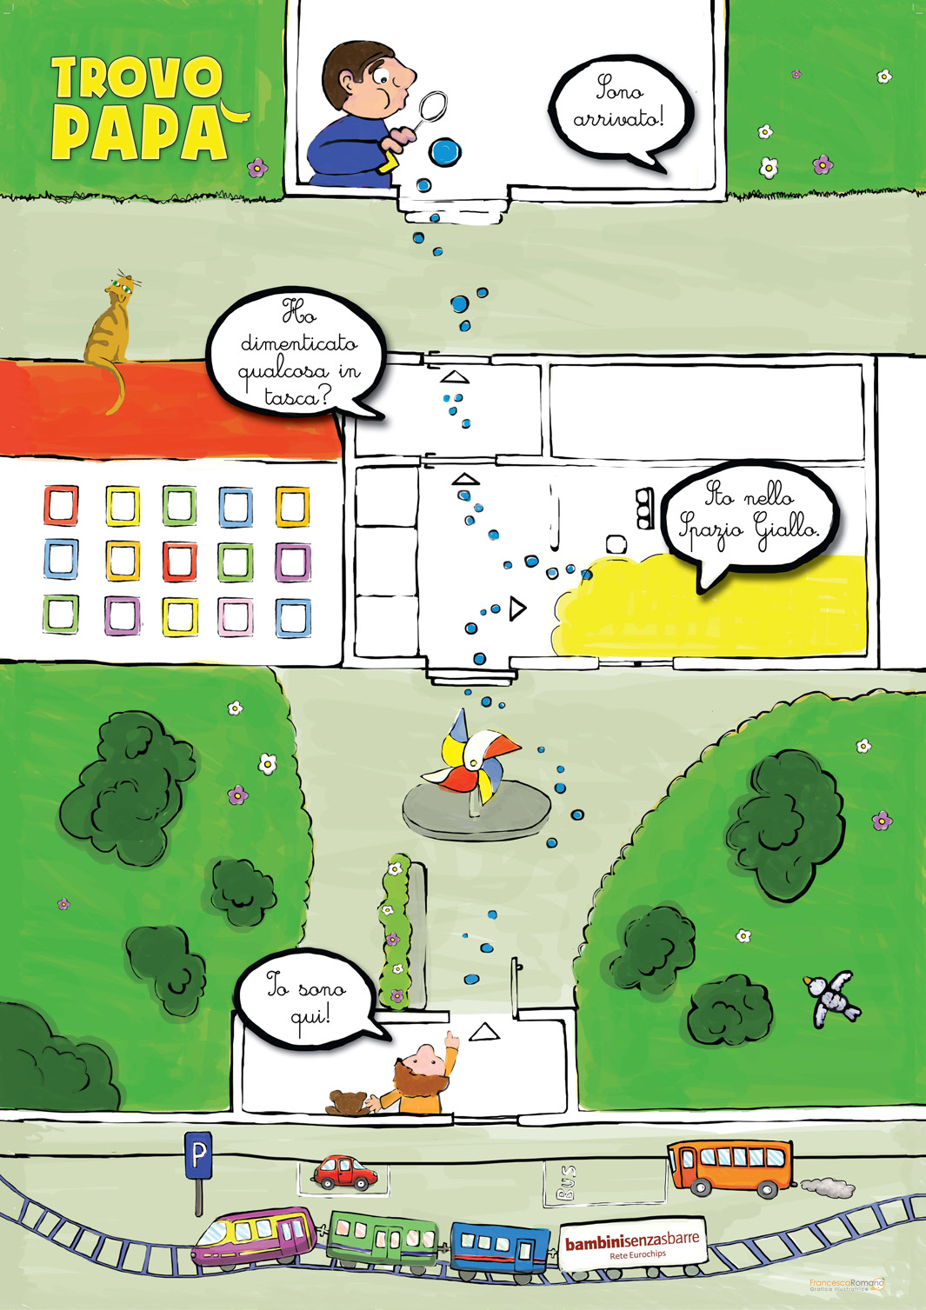
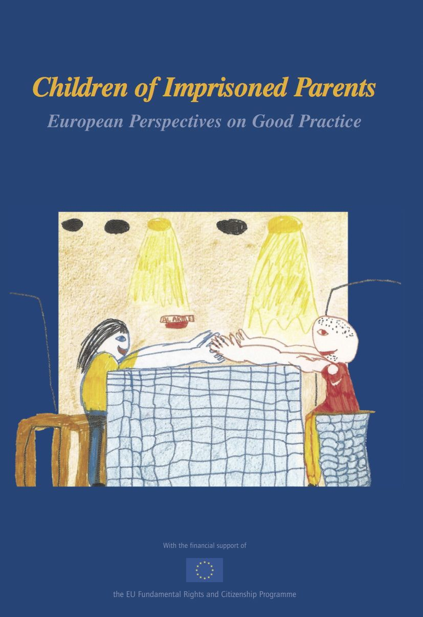
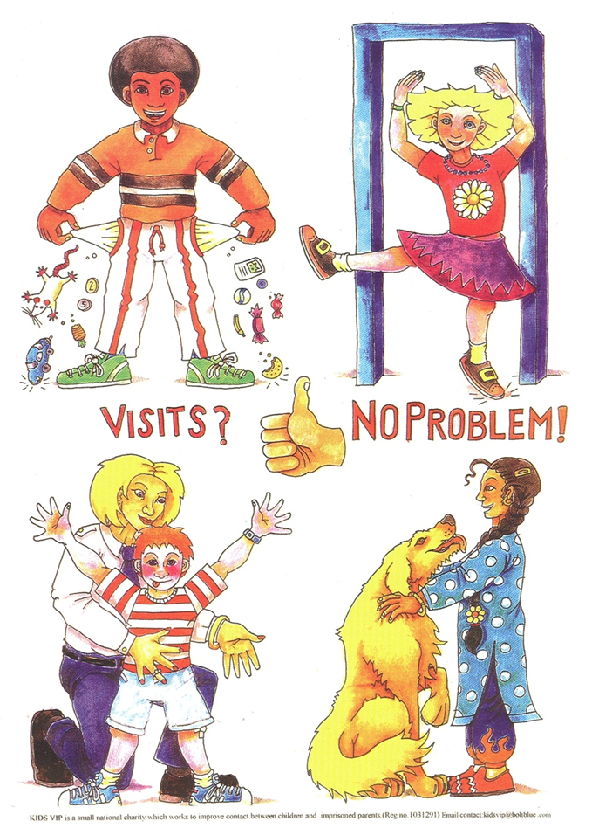
Promoting good practice
Children of Prisoners Europe

Slide 17
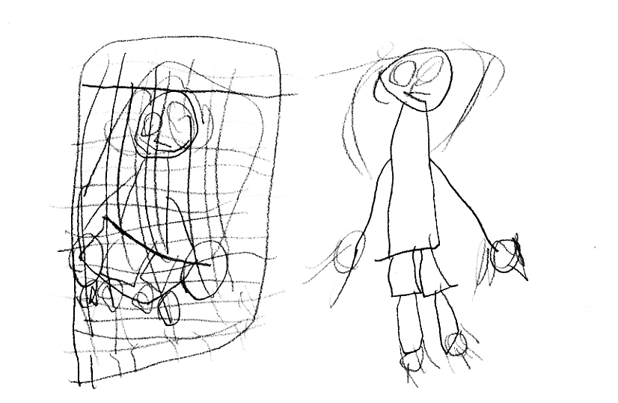
Ethical considerations
Children of Prisoners Europe
“Aligning oneself with a just cause does not guarantee just action.”

Slide 18
Children of prisoners… in Europe
Children of Prisoners Europe
1989 UN Convention on the Rights of the Child (Article 9, separation)
2000 European Network for Children of Imprisoned Parents (Eurochips) founded
2006 First pan-European conference on issue
2008 EP motion for resolution on impact of parental imprisonment
2009 1st EU-funded transnational project on rights of children of prisoners
2010 1st EU-funded transnational project with children of prisoners (n=987) on needs
2011 UN Day of General Discussion
2013 EU & UNICEF lists of “vulnerable children”
2014 European Parliament Resolution on the 25th anniversary of the UNCRC (Article 13)
2015 Written Response from Commissioner for Justice, European Commission
2016 Council of Europe Strategy on the Rights of the Child (2016-2021)
2016 European Parliament Written Declaration on children of imprisoned parents
2017 …

Slide 19
Looking forward…
Children of Prisoners Europe
Council of Europe
United Nations
European Union
Notes:
HL

Slide 20
Looking forward…
Children of Prisoners Europe
Council of Europe
Council for Penological Co-Operation (PC-CP)
+
European Committee on Crime Problems (CDPC)
Committee of Ministers Recommendation
on children with imprisoned parents (2017)

Slide 21
Looking forward…
Children of Prisoners Europe
Council of Europe
United Nations
European Union

Slide 22
Looking forward…
Children of Prisoners Europe
United Nations
Intersessional Briefing for States
1 February 2017
Memorandum of Understanding (Italian example)
Chair of the UN Committee on the Rights of the Child
Handbook on Children with Incarcerated Parents
UNODC, UNICEF & OHCHR joint handbook

Slide 23
Looking forward…
Children of Prisoners Europe
Council of Europe
United Nations
European Union

Slide 24
Memorandum of Understanding (Italy)
Children of Prisoners Europe
Italian Ministry of Justice,
Ombudsman for Childhood and Adolescence
&
Bambinisenzasbarre
Judicial orders, judgments and sentences
Children visiting prisons
Other types of contact
Training of prison staff
Information and support
Data collection
Children living with mothers in prison
Monitoring committee

Slide 25
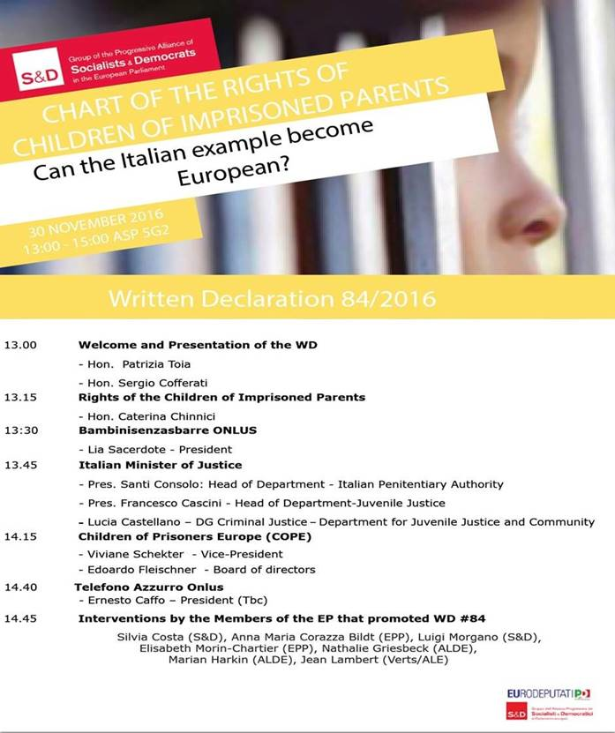
Children of Prisoners Europe

Slide 26
European Union
Children of Prisoners Europe
Memorandum of Understanding
Written Declaration
Parliamentary Questions
The Open Method of Coordination?
What else?

Slide 27
Challenges and priorities
Children of Prisoners Europe
CHALLENGES Data collection Policy gaps Abstract nature
Reaching those “hard-to-reach” children
Cultural differences (also positive) Biggest change needed is attitudinal
Funding beyond the EU
Mainstreaming for child protection and support agencies
PRIORITIES
Italian Memorandum of Understanding
Non-violent role models for children
Strategic framing for advocacy
Data collection
Funding beyond the EU

Slide 28
Next steps:
Children of Prisoners Europe
New in-schools initiative
across Europe

Slide 29
It’s time to act
Children of Prisoners Europe
Please leave the postcard with your name + one action you’d like to take to benefit children of prisoners

Slide 30
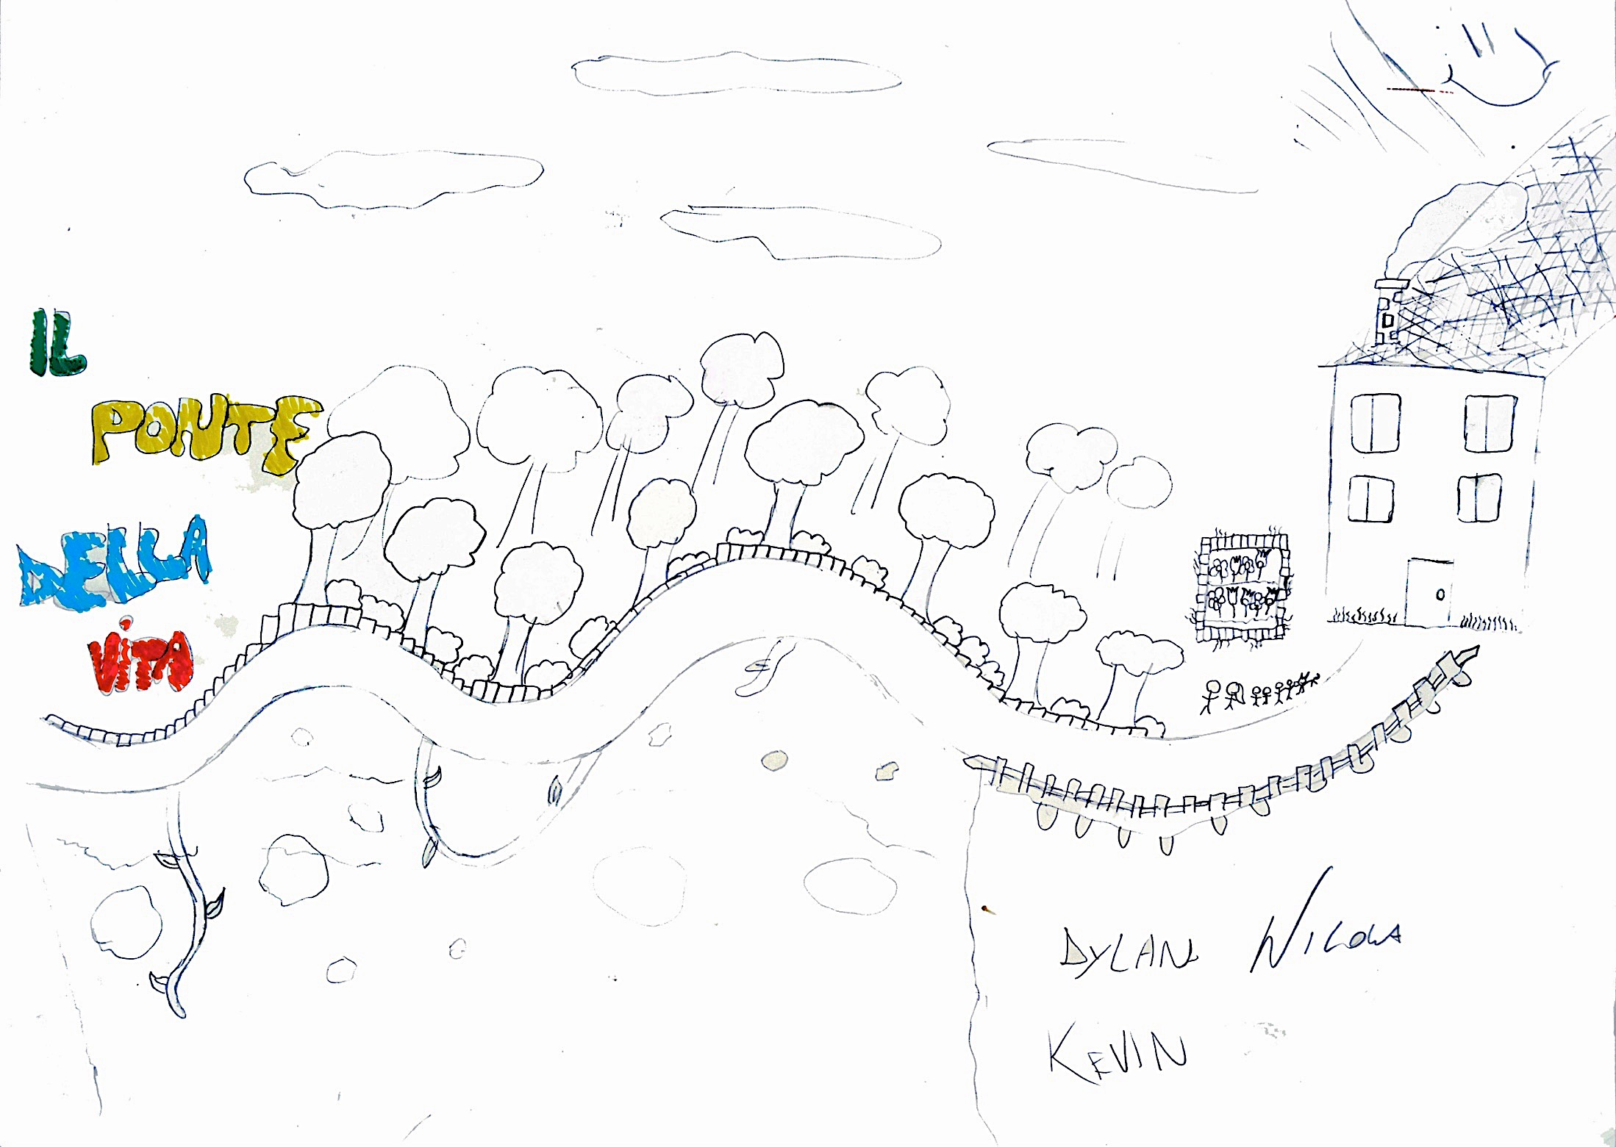
Thank you
Children of Prisoners Europe
“When Dad comes home everything will be resolved and the road will become straight again“
Dylan, 11 years old
Hannah Lynn | Kate Philbrick
Children of Prisoners Europe (COPE)
contact@networkcope.eu
10 January 2017
Quality of Childhood session
European Parliament

Slide 31
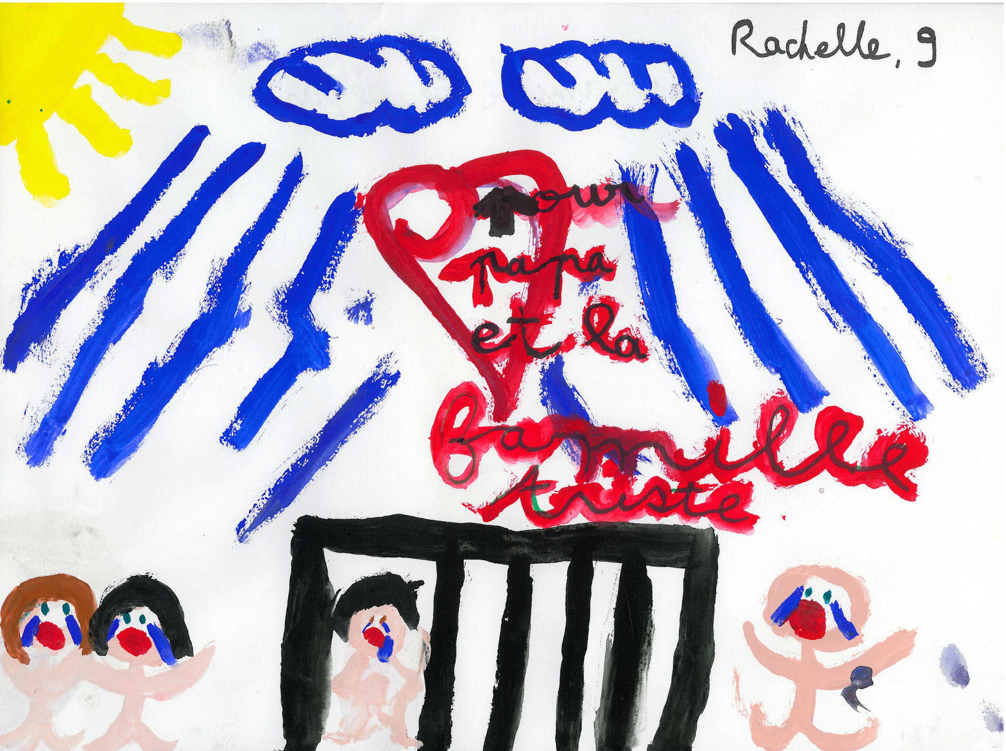
Thank you
Children of Prisoners Europe
Kate Philbrick | Hannah Lynn
contact@networkcope.eu
Children of Prisoners Europe (COPE)
10 January 2017
Quality of Childhood session
European Parliament

Slide 32
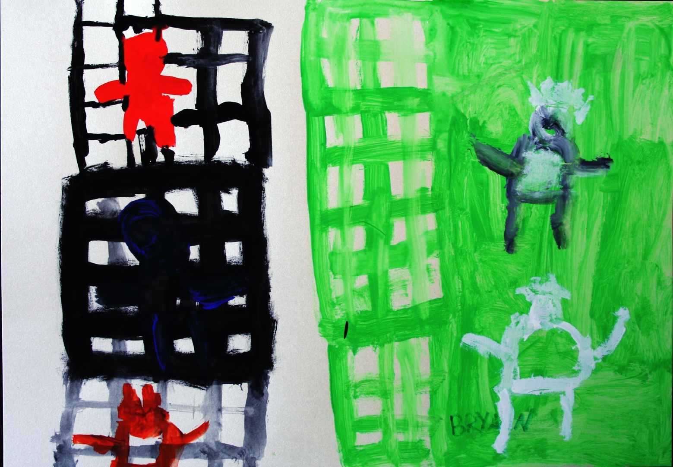
Thank you
Children of Prisoners Europe
Kate Philbrick | Hannah Lynn
contact@networkcope.eu
Children of Prisoners Europe (COPE)
10 January 2017
Quality of Childhood session
European Parliament

Slide 33
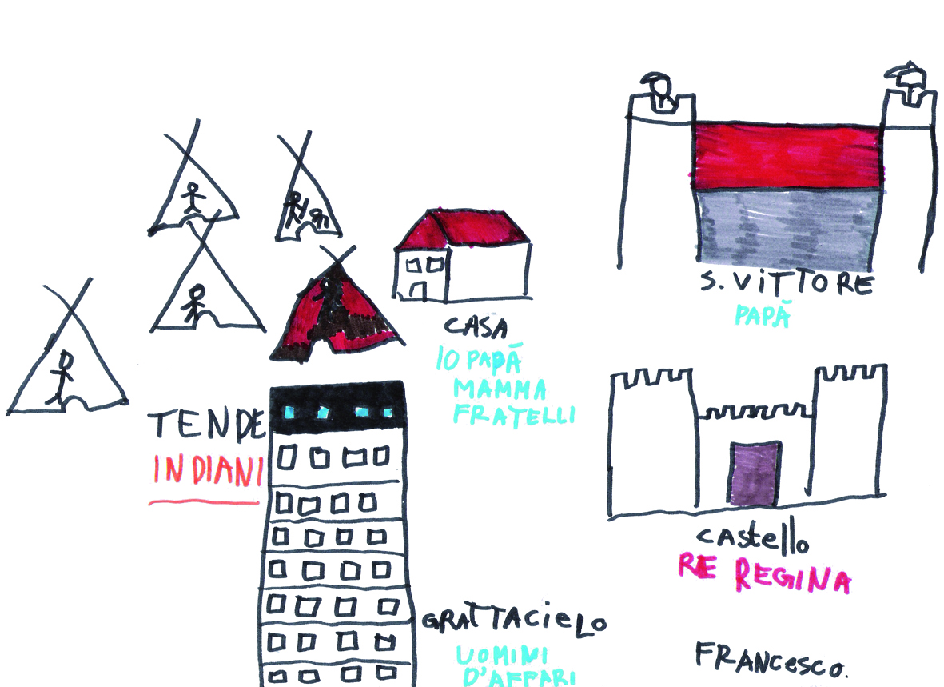
Thank you
Children of Prisoners Europe
Kate Philbrick | Hannah Lynn
contact@networkcope.eu
Children of Prisoners Europe (COPE)
10 January 2017
Quality of Childhood session
European Parliament

Slide 34
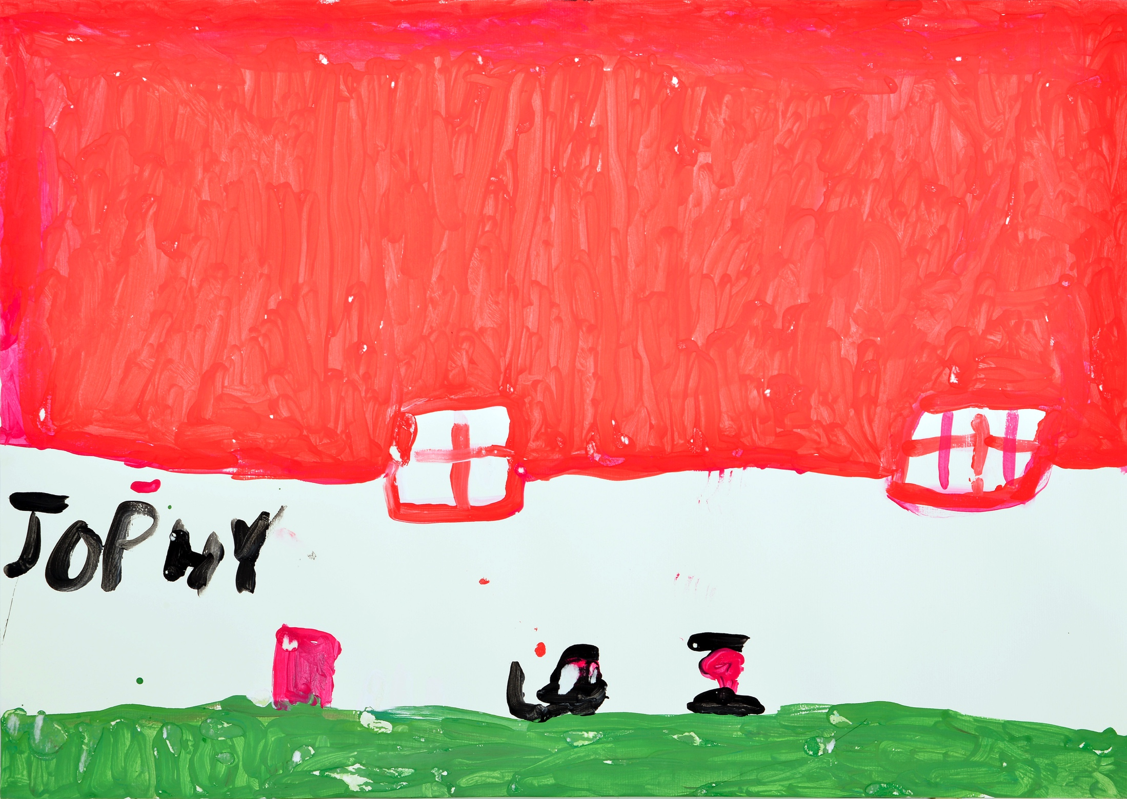
Thank you
Children of Prisoners Europe
“The big wall scares me”
Jophy, 7 years old
Kate Philbrick | Hannah Lynn
contact@networkcope.eu
Children of Prisoners Europe (COPE)
10 January 2017
Quality of Childhood session
European Parliament

Slide 35
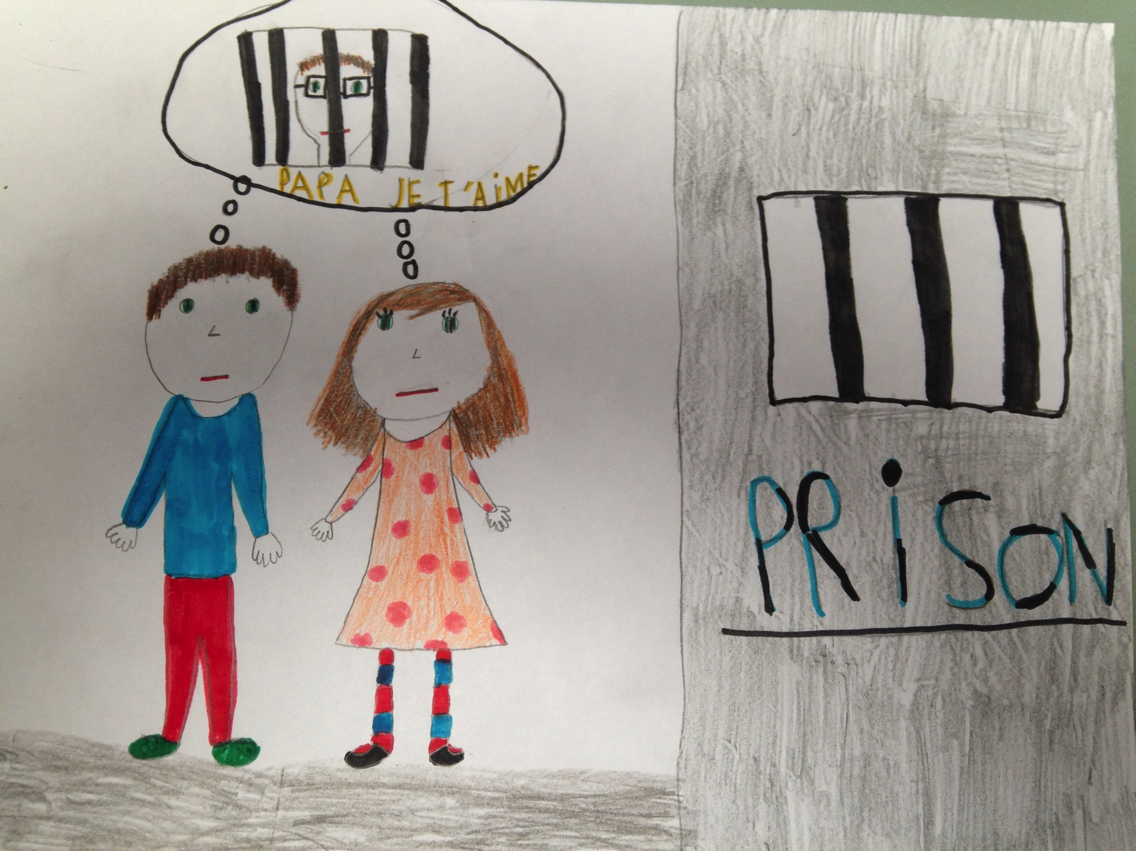
Thank you
Children of Prisoners Europe
Kate Philbrick | Hannah Lynn
contact@networkcope.eu
Children of Prisoners Europe (COPE)
10 January 2017
Quality of Childhood session
European Parliament

Slide 36
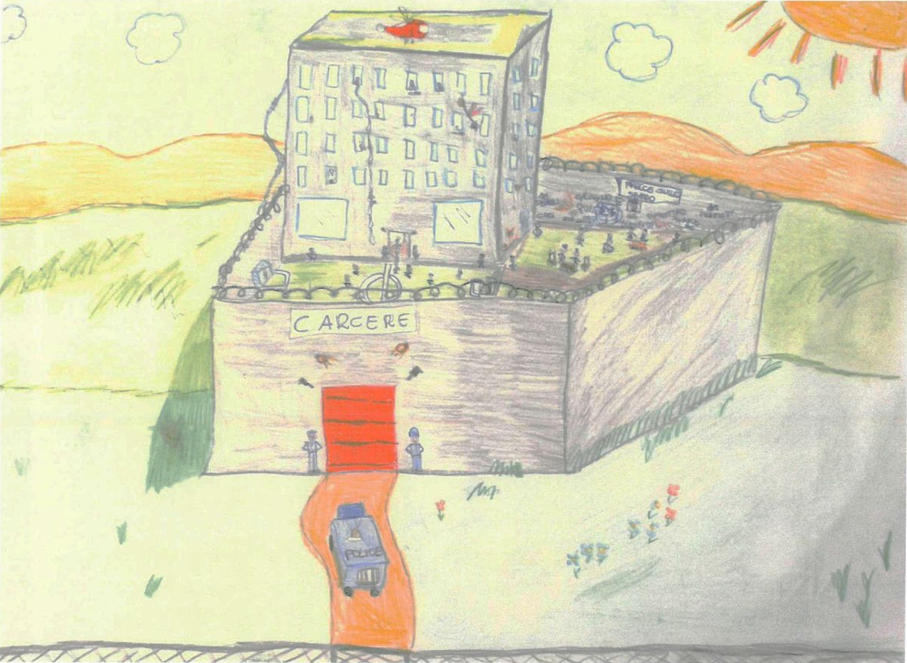
Thank you
Children of Prisoners Europe
Kate Philbrick | Hannah Lynn
contact@networkcope.eu
Children of Prisoners Europe (COPE)
10 January 2017
Quality of Childhood session
European Parliament

Slide 37
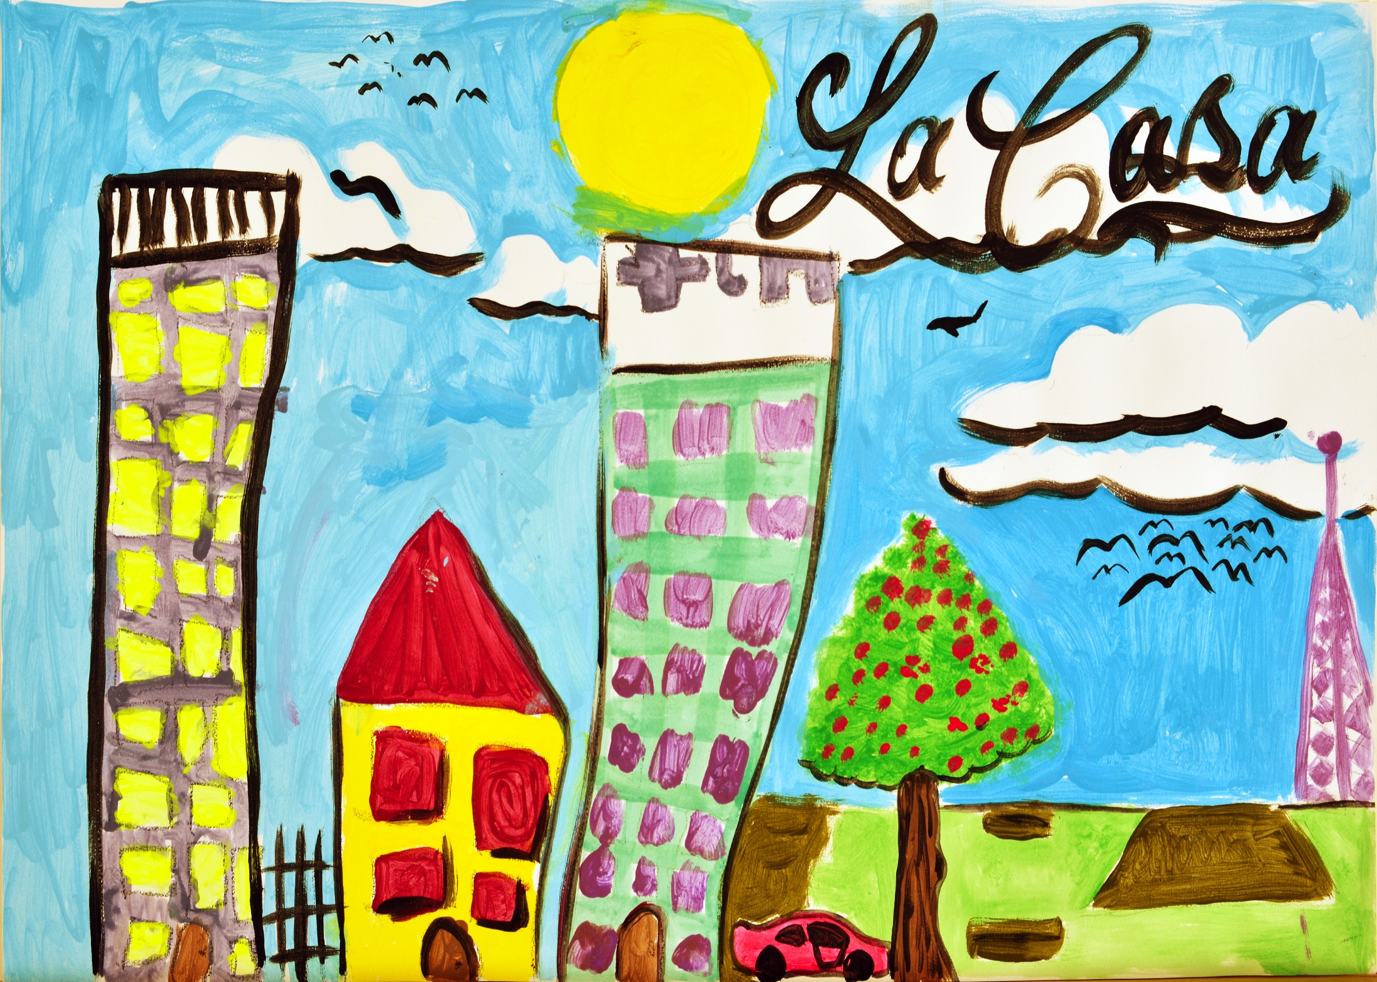
Thank you
Children of Prisoners Europe
Kate Philbrick | Hannah Lynn
contact@networkcope.eu
Children of Prisoners Europe (COPE)
10 January 2017
Quality of Childhood session
European Parliament

Slide 38
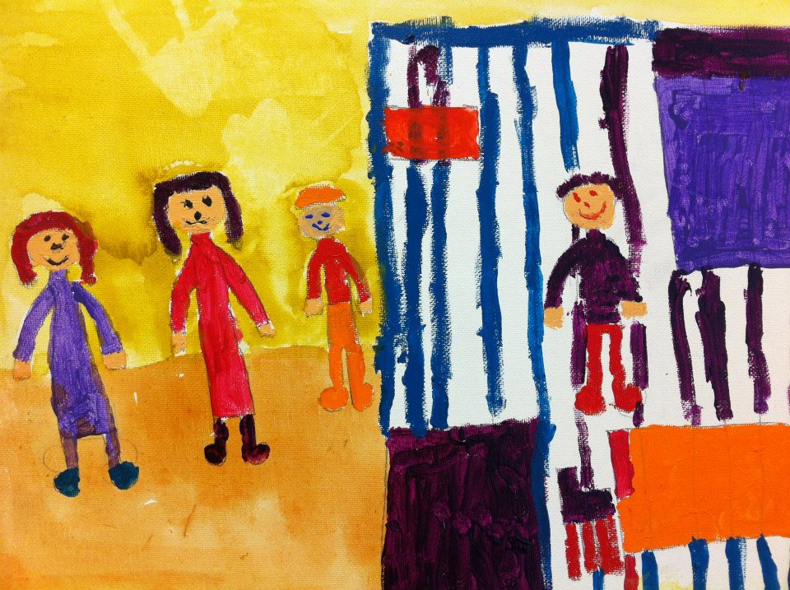
Thank you
Children of Prisoners Europe
Kate Philbrick | Hannah Lynn
contact@networkcope.eu
Children of Prisoners Europe (COPE)
10 January 2017
Quality of Childhood session
European Parliament

Slide 39
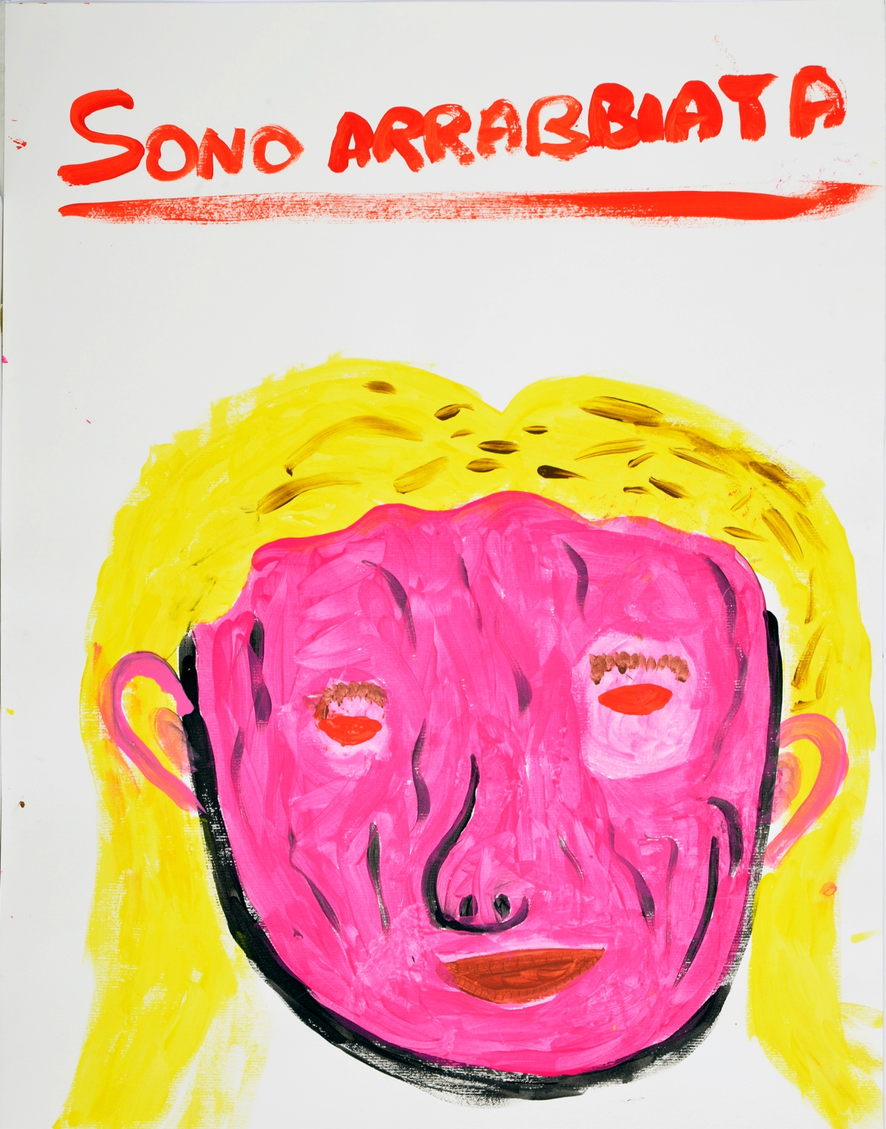
Thank you
Children of Prisoners Europe
“Io sono arrabbiata con papà, ma non dico perché”
/
“I’m angry at my dad, but I don’t say why”
Viola, 6 years old
Kate Philbrick | Hannah Lynn
contact@networkcope.eu
Children of Prisoners Europe (COPE)
10 January 2017
Quality of Childhood session
European Parliament

Slide 40
Food for thought
Children of Prisoners Europe
If you were a child of a prisoner, how would you want to be treated?
How could you envisage making one change within your work setting, to support a child whose parent is in prison?
Notes:
Small group work answering 2 questions
1. If you were a child of a prisoner, how would you want to be treated?
2. How could you envisage making one change within your work setting, to support a child whose parent is in prison?
For discussions: What they can do, what we can do for them, anything we could do differently to support the children better, and what COPE could do differently to further the interests of the children?

Slide 41
Food for thought
Children of Prisoners Europe
If you were a child of a prisoner, how would you want to be treated?
How could you envisage making one change within your work setting, to support a child whose parent is in prison?
Notes:
Small group work answering 2 questions
1. If you were a child of a prisoner, how would you want to be treated?
2. How could you envisage making one change within your work setting, to support a child whose parent is in prison?
For discussions: What they can do, what we can do for them, anything we could do differently to support the children better, and what COPE could do differently to further the interests of the children?

