Slide 1
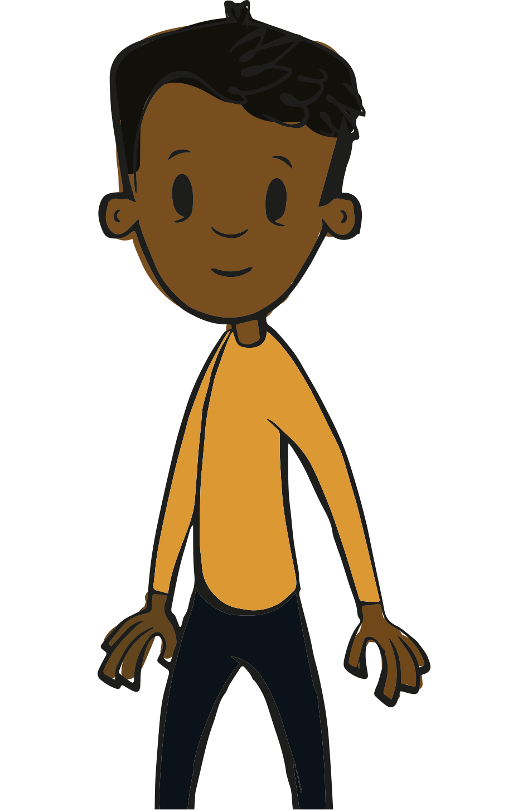
Papa Plus in COPE’s multidisciplinary systems approach
Children of Prisoners Europe
Support for imprisoned parent
Support for caretakers
/ communities
Support for professionals and NGOs (COPE)
Support for schools
Support for child
Support for prison staff
Support for police
Training for sentencers
With thanks to Martin Manby

